Slide 1
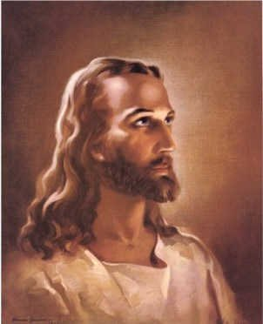
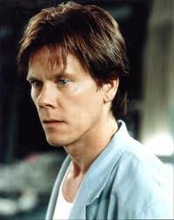
Oikos Mapping
RELATIONAL
INTENTIONAL
DEVELOPMENT

Slide 2
Jesus brings cousin John
John brought Andrew
J
J
Andrew brought Simon
A
Simon brought James, John and mother-in-law
S
Simon bridged into Cornelius oikos
J
J
Cultural boundaries
ML
He and his “oikos” were saved
C
Acts 10
Jesus and His Oikos

Slide 3
The virus of the Kingdom was meant to spread across relational lines
Jesus and His Oikos

Slide 4
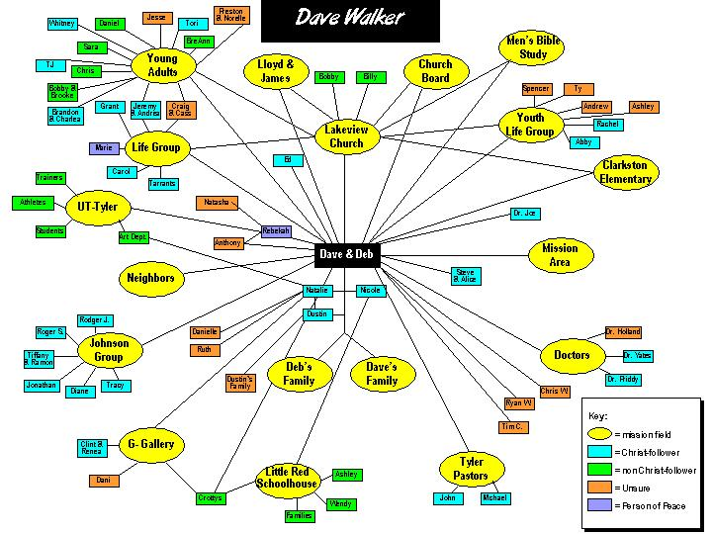
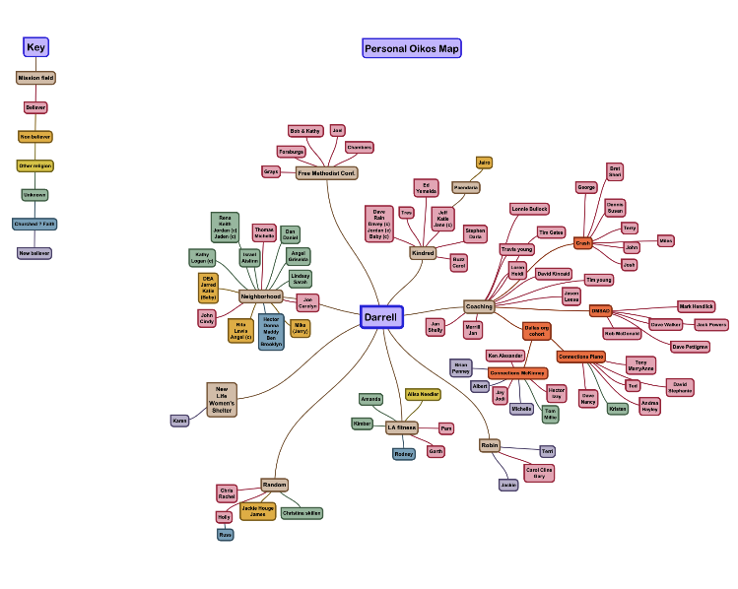
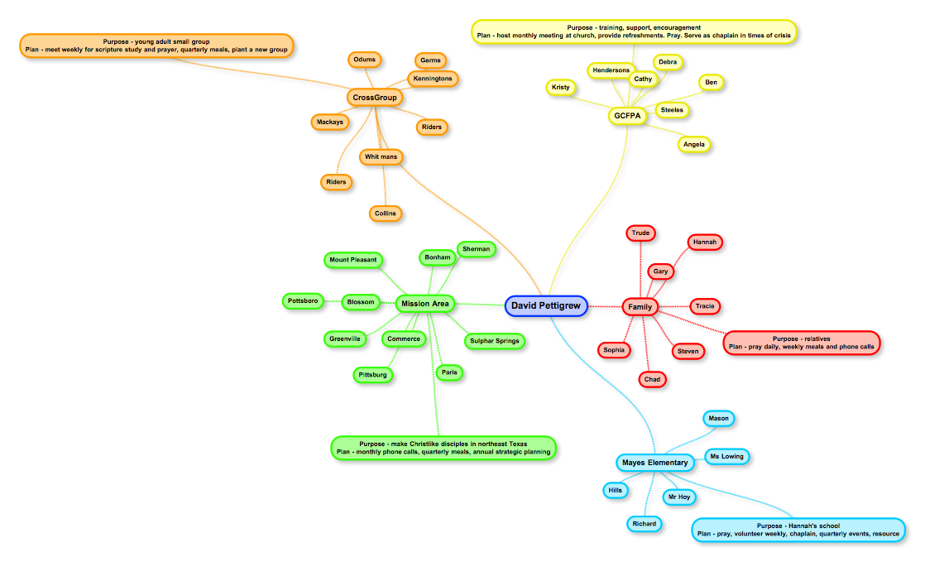
Apartment
Complex
Mission Fields

Slide 5
Develop
a
Key
Identify
People

Slide 6
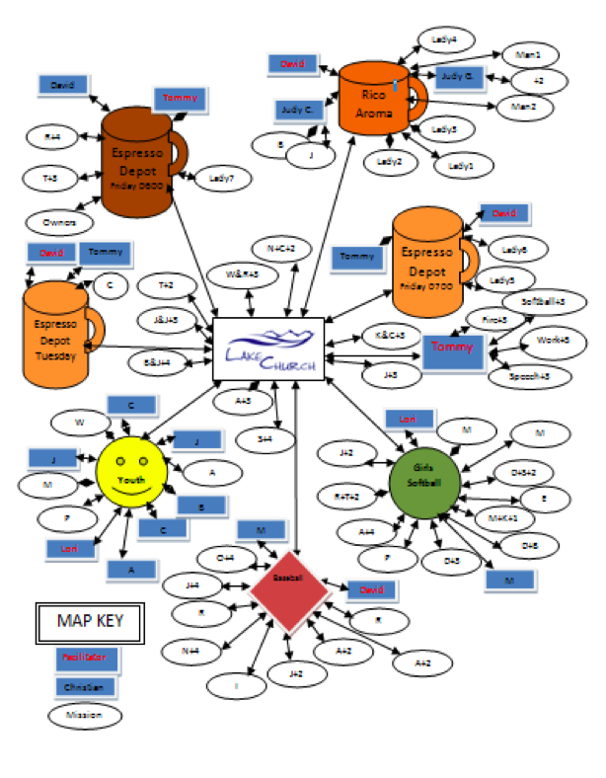
Maximizing Your Map
Strategic Prayer Tool
Strategic Time Management Tool
Strategic Corporate Outreach Tool

Slide 7
Strategic Prayer Tool
Pray specifically
Specific prayer leads to intentional action

Slide 8
Strategic Time Management Tool
how much time I spend with non -Christians
Time dedicated to missional multiplication

Slide 9
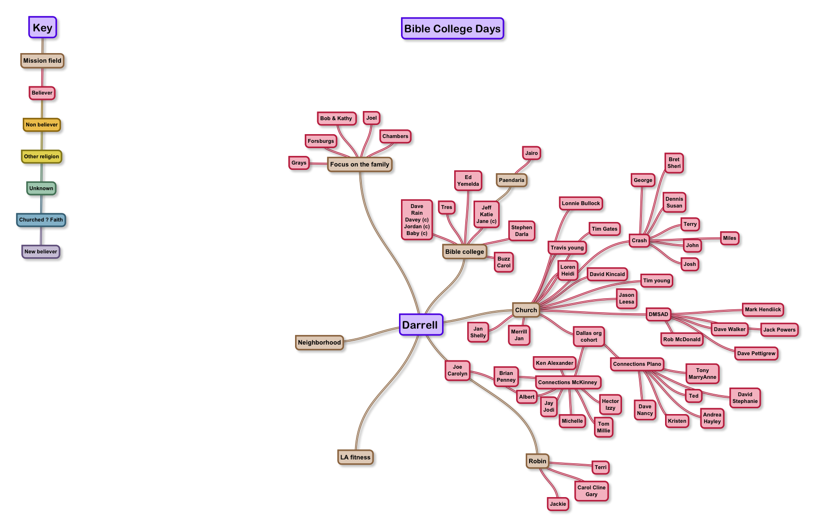
What if your map looks like this?
Time to intentionally enter new fields

Slide 10
What if your map looks like this?
How do you meet non-believers?
What keeps us from meeting and building relationships with Non believers?
Neighborhood BBQ
Regular 3rd Space
Meetup.com

Slide 11
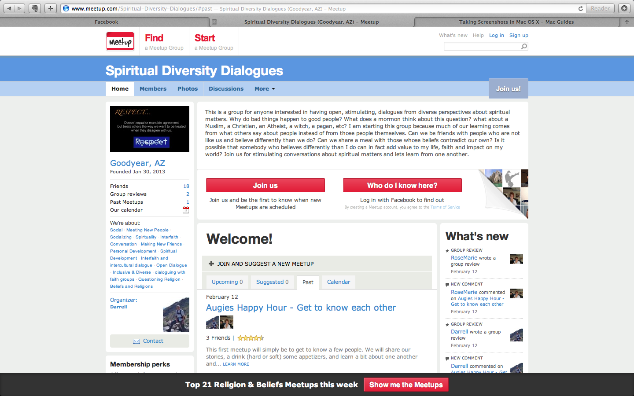
Meetup.com
This is a group for anyone interested in having open, stimulating, dialogues from diverse perspectives about spiritual matters. Why do bad things happen to good people? What does a mormon think about this question? what about a Muslim, a Christian, an Atheist, a witch, a pagan, etc? I am starting this group because much of our learning comes from what others say about people instead of from those people themselves. Can we be friends with people who are not like us and believe differently than we do? Can we share a meal with those whose beliefs contradict our own? Is it possible that somebody who believes differently than I do can in fact add value to my life, faith and impact on my world? Join us for stimulating conversations about spiritual matters and lets learn from one another.

Slide 12
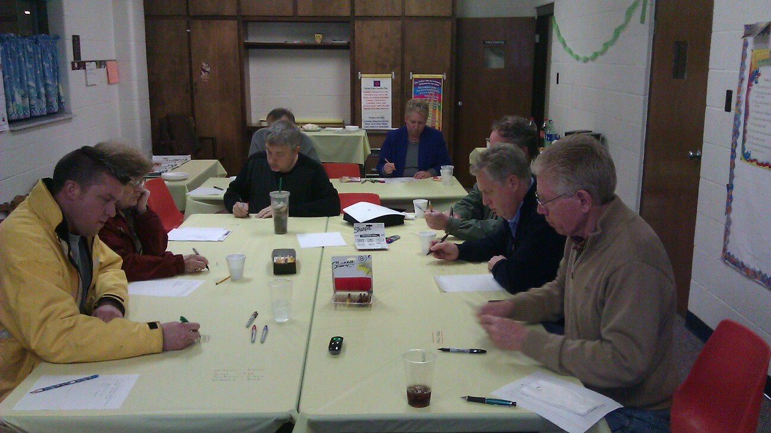
Strategic Corporate Outreach

Slide 13
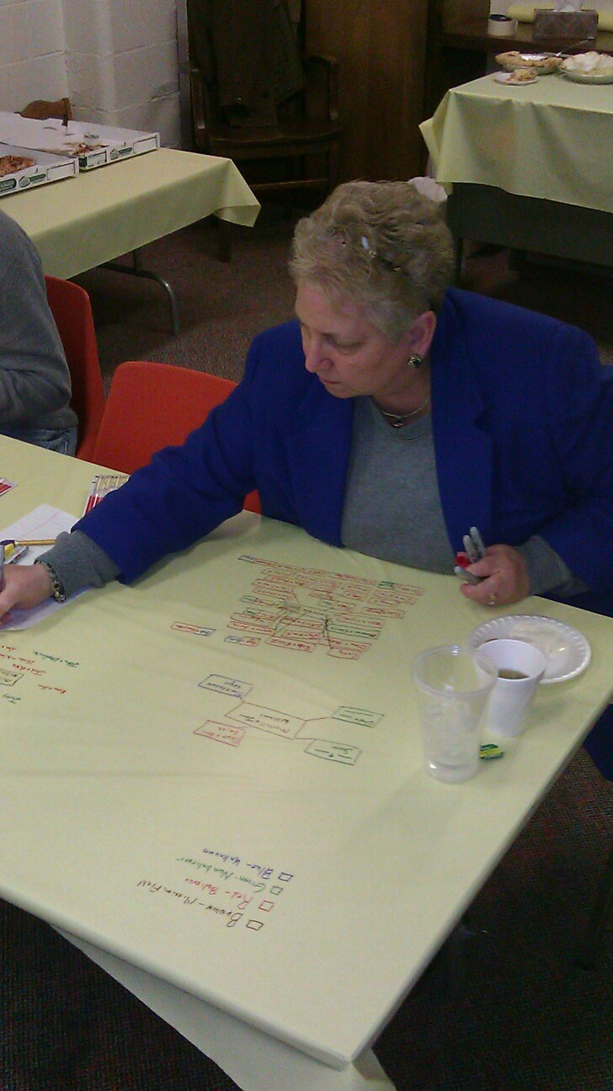
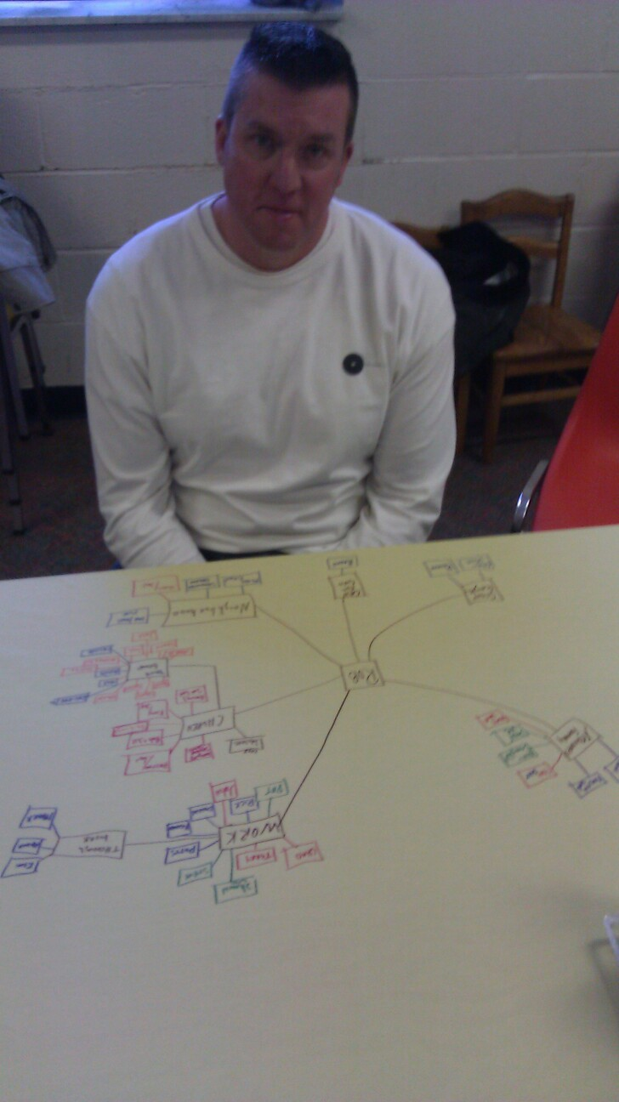
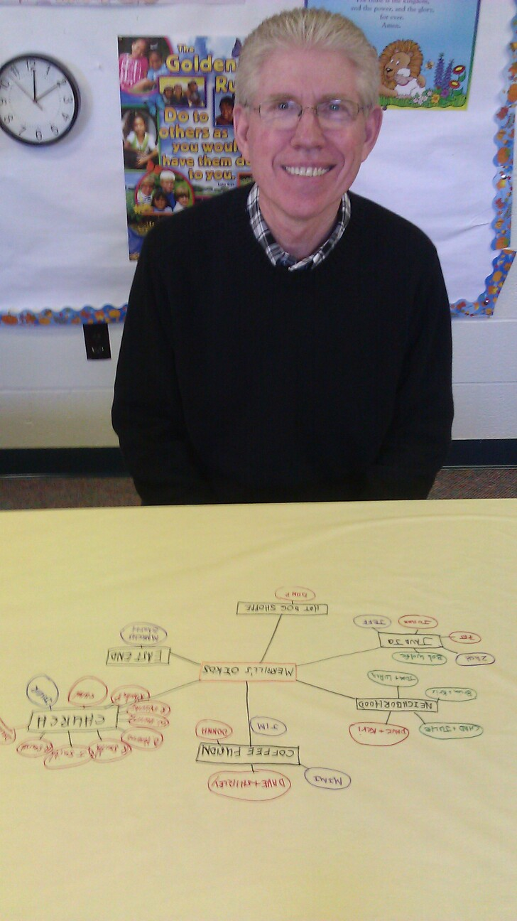
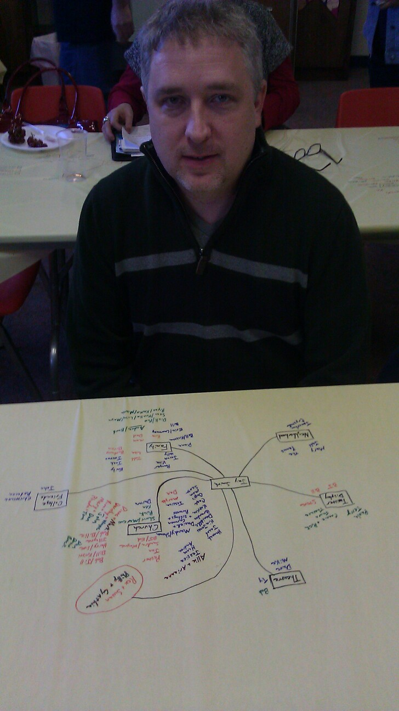
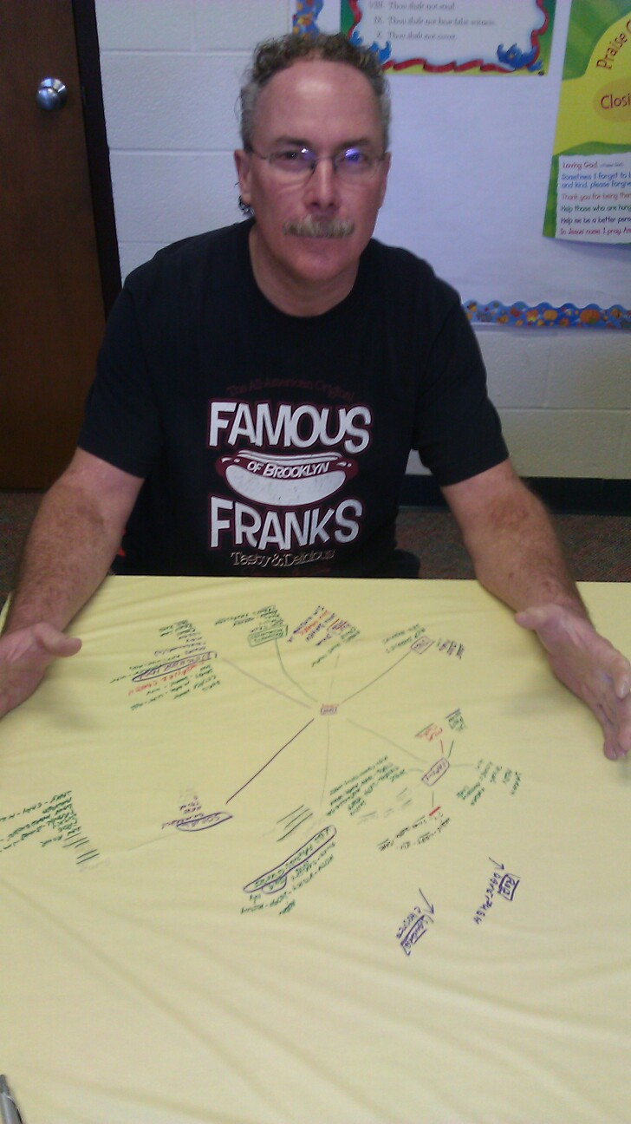
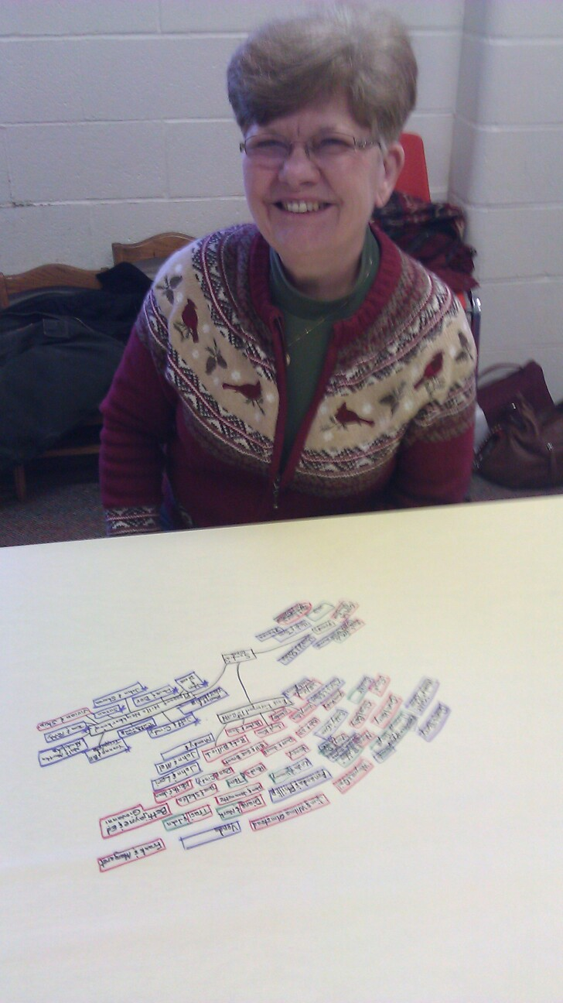
Strategic Corporate
Outreach

Slide 14
Insights
How do you see this fitting into your personal life?
How do you see this fitting into our mission as a church?

Slide 15
Start Your Map With What You Know
Jay/Jodi
Ron/Rachael
Hector
Church
You
Randy
ED/Michelle
John
Eric/Jill
Mark/Jane/Danny
Neighborhood
Carol/eddie/Lisa
Jim/Susie
Randy
Work

Slide 16
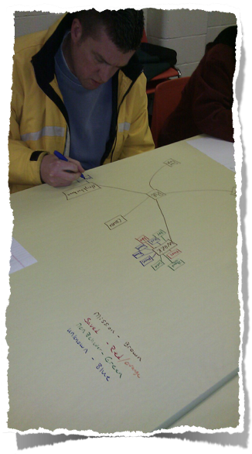
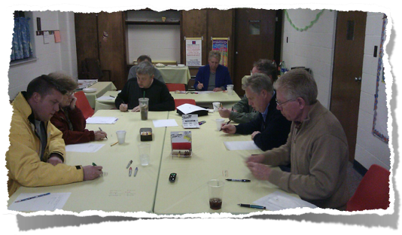
Group Mapping Project
Key
Mission Field - Brown
Believers - Red
Non Believer - Green
Unknown - Blue

